Slide 1

Capstone Project Presentation
Data Science with Python
Student: Reza Nickmanesh
Mentor: Serena Perruzo
april 2018

Slide 2
Overview
Project Description
Domain Knowledge
Dataset
Exploratory Analysis
Vectorization of text data
Model Building
Results and Discussion

Slide 3
Project Description
Project objective: SMS spam detection
Model evaluation metrics: accuracy, precision, f1 score, and recall

Slide 4
Domain Knowledge
The growth of the mobile phone users has led to a dramatic increase in SMS spam messages.
This project analyses different machine learning classifiers on large corpus of SMS messages to develop a reliable filtering framework
We determined the benchmark model based on a paper [1] which reviewed works related to spam detection problem. Considering the average and range of accuracies that previous investigators have achieved, we set the 95% accuracy as our benchmark.

Slide 5
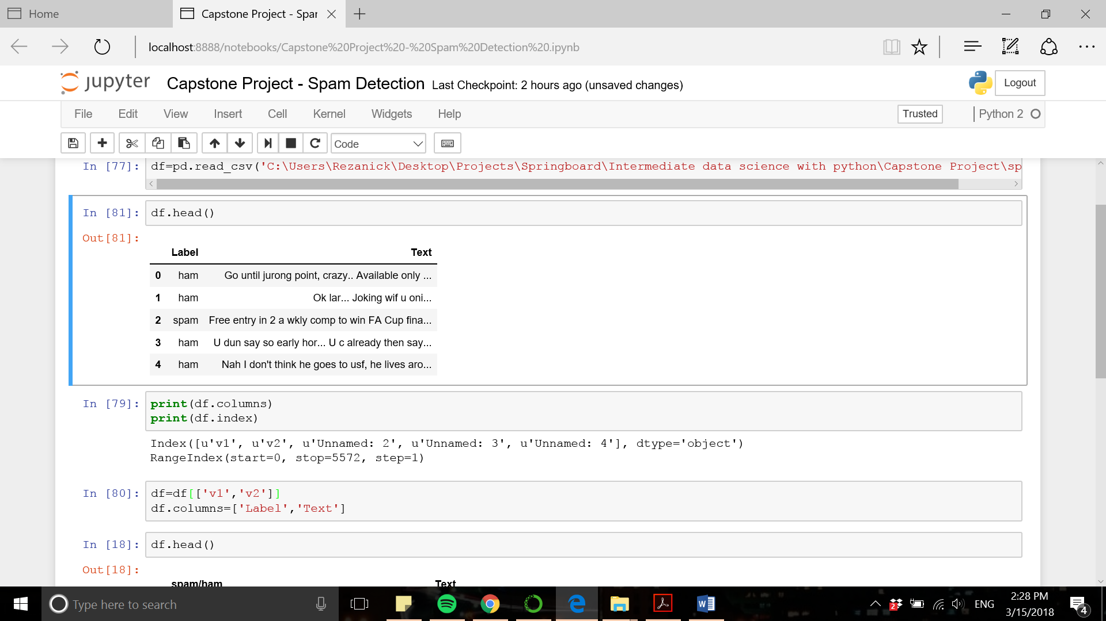
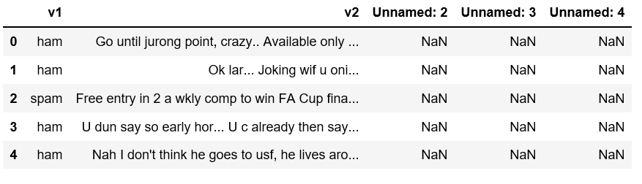
Dataset
SMS spam detection dataset [2] consisted of 5572 entries (4825 ham messages and 747 spam messages).
The first two columns (‘v1’ and ‘v2) are renamed into more meaningful column names (‘Label’ and ‘Text’, respectively) and the three redundant columns are dropped. The cleaned data frame is shown below and is ready for exploratory data analysis.

Slide 6
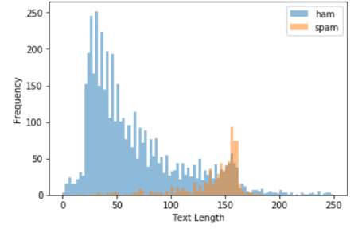
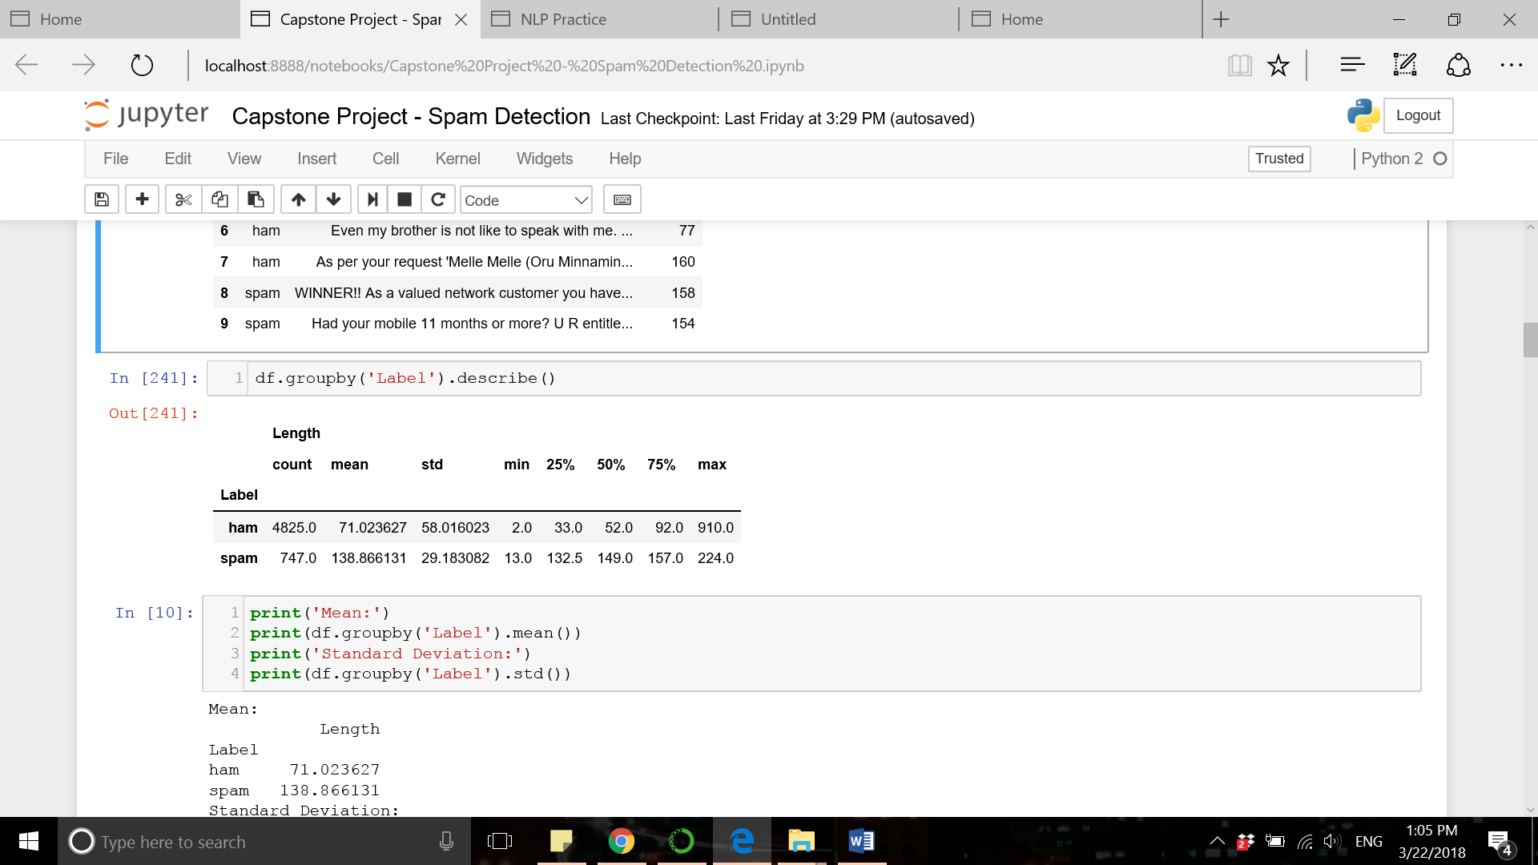
Exploratory Analysis
Distribution of length of text messages in spam and ham messages:

Slide 7
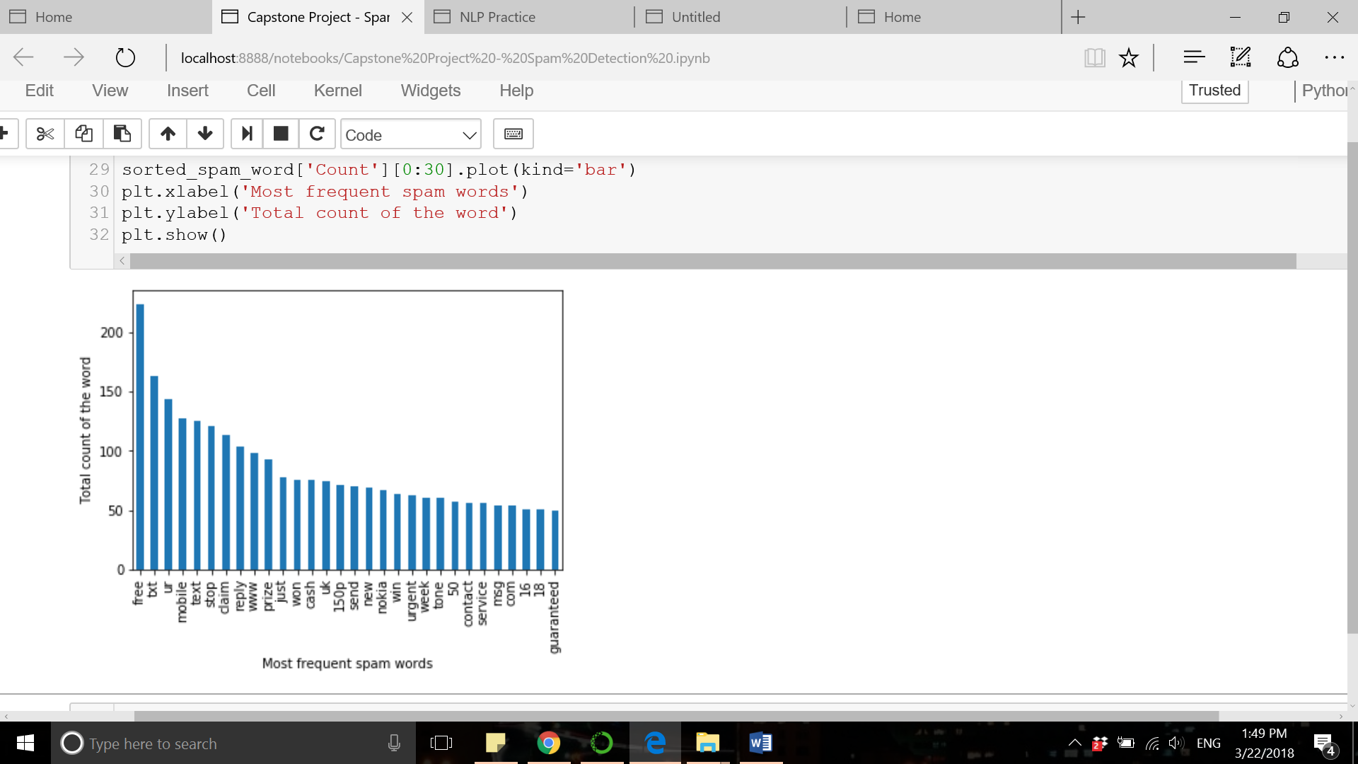
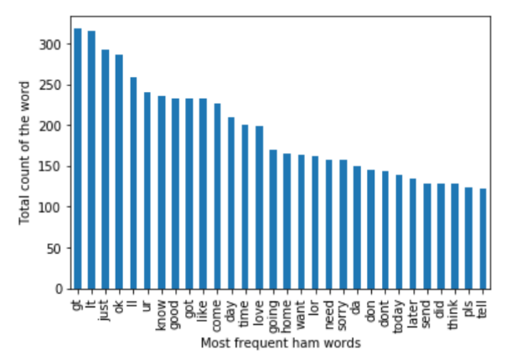
Exploratory Analysis
Most frequent words in spam and ham messages:

Slide 8
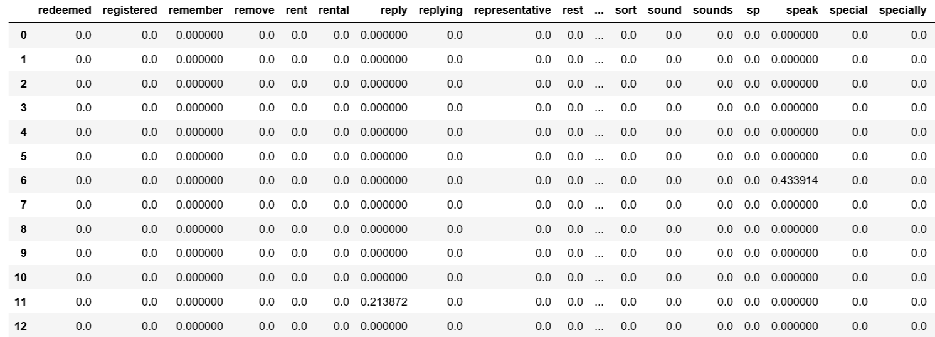
Vectorization of Text Data using Tf-idf
The tf-idf value increases proportionally to the number of times a word appears in a document and is offset by the frequency of the word in the corpus.
Tf-idf method gives weights to each word in each document based on the level of its importance to the document.

Slide 9
Model Building
The first 1000 important words according to tf-idf ranking is selected as the features for classification.
The following machine learning classifiers are trained and explored in the current project:
  Support vector machine
  K nearest neighbors
  Naïve Bayes
  Decision tree
  Logistic regression
  Random forest
  Adaboost
  Bagging

Slide 10
Model Building (Hyperparameter Tuning )
The hyperparameters for each classifier are tuned by implementing cross validation and find the optimal parameter based on accuracy:
Classifier | Abbreviation | Hyperparameters | Value range/Options | Tuned value
Support Vector Machine | SVC | Kernel | 'rbf', 'poly', 'sigmoid' | ‘sigmoid’
 |  | Gamma | np.linspace(0.05, 1, num=10) | 0.78
K Nearest Neighbors | KN | N_neighbors | range(3,25) | 3
Naïve Bayes | NB | Alpha | np.linspace(0.05, 1, num=10) | 0.05
Decision Tree | DT | Min_samples_split | range(2,21) | 15
Logistic Regression | LR | Solver | 'newton-cg', 'lbfgs', 'liblinear', 'sag' | ‘newton-cg’
Random Forest | RF | N_estimators | range(2,36) | 27
AdaBoost | AdaBoost | N_estimators | range(2,21) | 19
Bagging | BgC | N_estimators | range(2,21) | 16

Slide 11
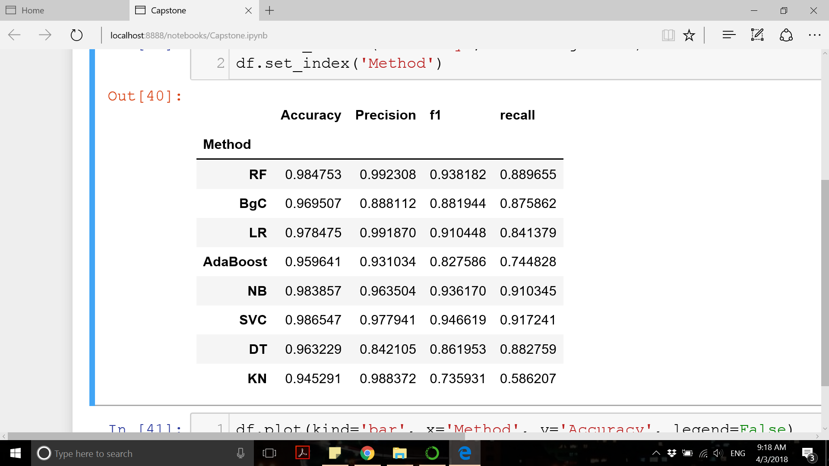
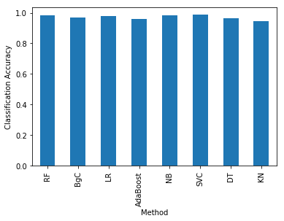
Results and Discussion
Model evaluation:
All classifiers showed an accuracy of above 94% with support vector machine classifier having the highest accuracy (98.6%) among all. Support vector classifier also showed good performance according to other metrics (precision=99%, f1=97.8%, and recall=91.7%).

Slide 12
Results and Discussion
Among all classifiers, the highest accuracy scores were for support vector machine, random forest, and naïve bayes classifiers (all above 98% accuracy) which outperformed the accuracy of our benchmark model (95%)

Slide 13
Future Work
The accuracy of machine learning classifiers in this project is good but there are ways/techniques to develop more accurate models:
  Neural Network method has proved to be a powerful method for classification problems
  More in-depth feature selection methods can improve the performance of the model

Slide 14
References
[1] Sarah Jane Delany et al. “SMS spam filtering: Methods and data”. Expert Systems with Applications
[2] https://archive.ics.uci.edu/ml/datasets/sms+spam+collection

